Slide 1
Supply chain team How to support them with Tech
Mecline Jose
June 2020

Slide 2
Executive Summary
The Supply chain Documentation functionality is only one part of the Fresh farms app which aims to support supply chain team in their daily work processes.The overall goal of the app is efficiency (by saving time), motivation (to always keep an eye on the shipment of the customer’s), digitalisation (collect feedback data for reports, analyses, inventory management, planning, etc.)
Key Findings
All drivers use their smartphones.This was a crucial finding. drivers need to calculate (delivery time) and look up safety of shipment, standards, etc. The app should be flexible: consider the drivers dominant hand as well as let them chose the task he/she wants. The wish for clear documenting is essential for all respondents.

Slide 3
What did I want to learn?
An app will only be accepted if it saves the customers delivery time, motivates them, and or brings value for the management. I wanted to get some insights about how an app must be designed to accomplish these goals.
Key Research Questions
Use of smartphone during work
The process of tackling shipment tasks
acceptance of feedback using an app

Slide 4
Participants
I recruited 4 Participants from 2 different companies in India*
 | Age & Gender | Role | Bakery
Participant 1 | 43, m | Delivery person (driver) | company A (10 employees)
Participant 2 | 23, f | Packing staff | company A
Participant 3 | 45, m | Delivery person (driver) | company B (5 employees)
Participant 4 | 33, m | Packing | Company B
* = Interviews were held in German, but results were translated

Slide 5
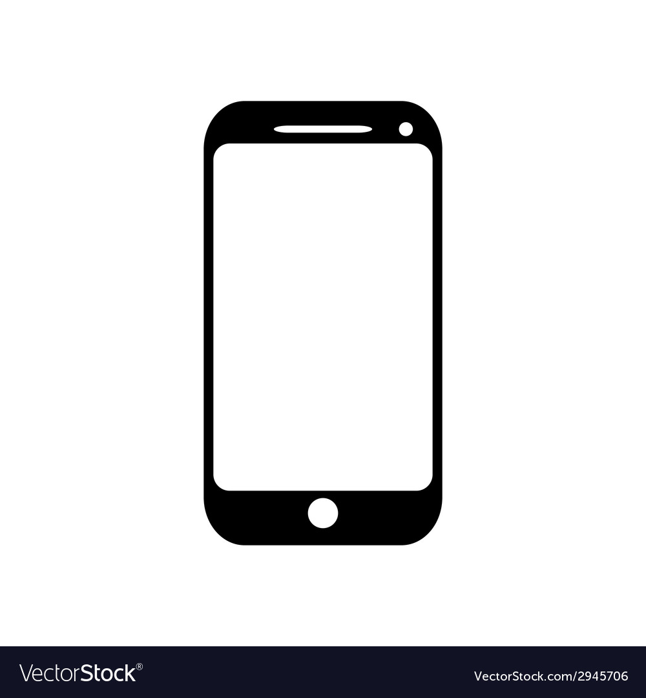
3 out of 3 Drivers carry and use their private smart phone while Driving
Key Finding 1

Slide 6
Recommendation #1
Drivers use their smartphone several times per day to calculation, making calls, internet surfing etc. This prerequisite for using a mobile app is therefore fulfilled. ✔
The app must be developed for iOS & Android as drivers use both main smartphone types.
Drivers use their smartphone most of the time with one hand.They use their non-dominant hand. The app should be setup differently for left- and right-handed user.

Slide 7


Lack of clear rules and collaboration
Key Finding 2

Slide 8
Recommendation #2
The app should show pictures & written instructions about the positive outcome of the shipment task. This makes it clear what outcome is expected from the delivery person .
No annoying forms to fill out, instead easy documentation of finished task by picture-taking. The app also saves automatically meta-data like data, user, etc. for reporting.

Slide 9
Everybody wishes a better documentation system
Key Finding 3
“Our checklist is not complete and outdated.” (driver #2)
“I want to know quickly when was what delivered by who.”
(QA officer)

Slide 10
Recommendation #3
Existing document methods are insufficient ✔
The app is ideal for documenting delivery results as drivers carry their smartphone with them during work.
Photo-taking is a quick & easy method for documenting the delivery results. Additional analysis (like AI-based evaluation of delivery results can be documented, too).

Slide 11
Next Steps
Undermine findings by quantitative analysis (survey)
Develop prototype
Test user acceptance

Slide 12
Appendix

Slide 13
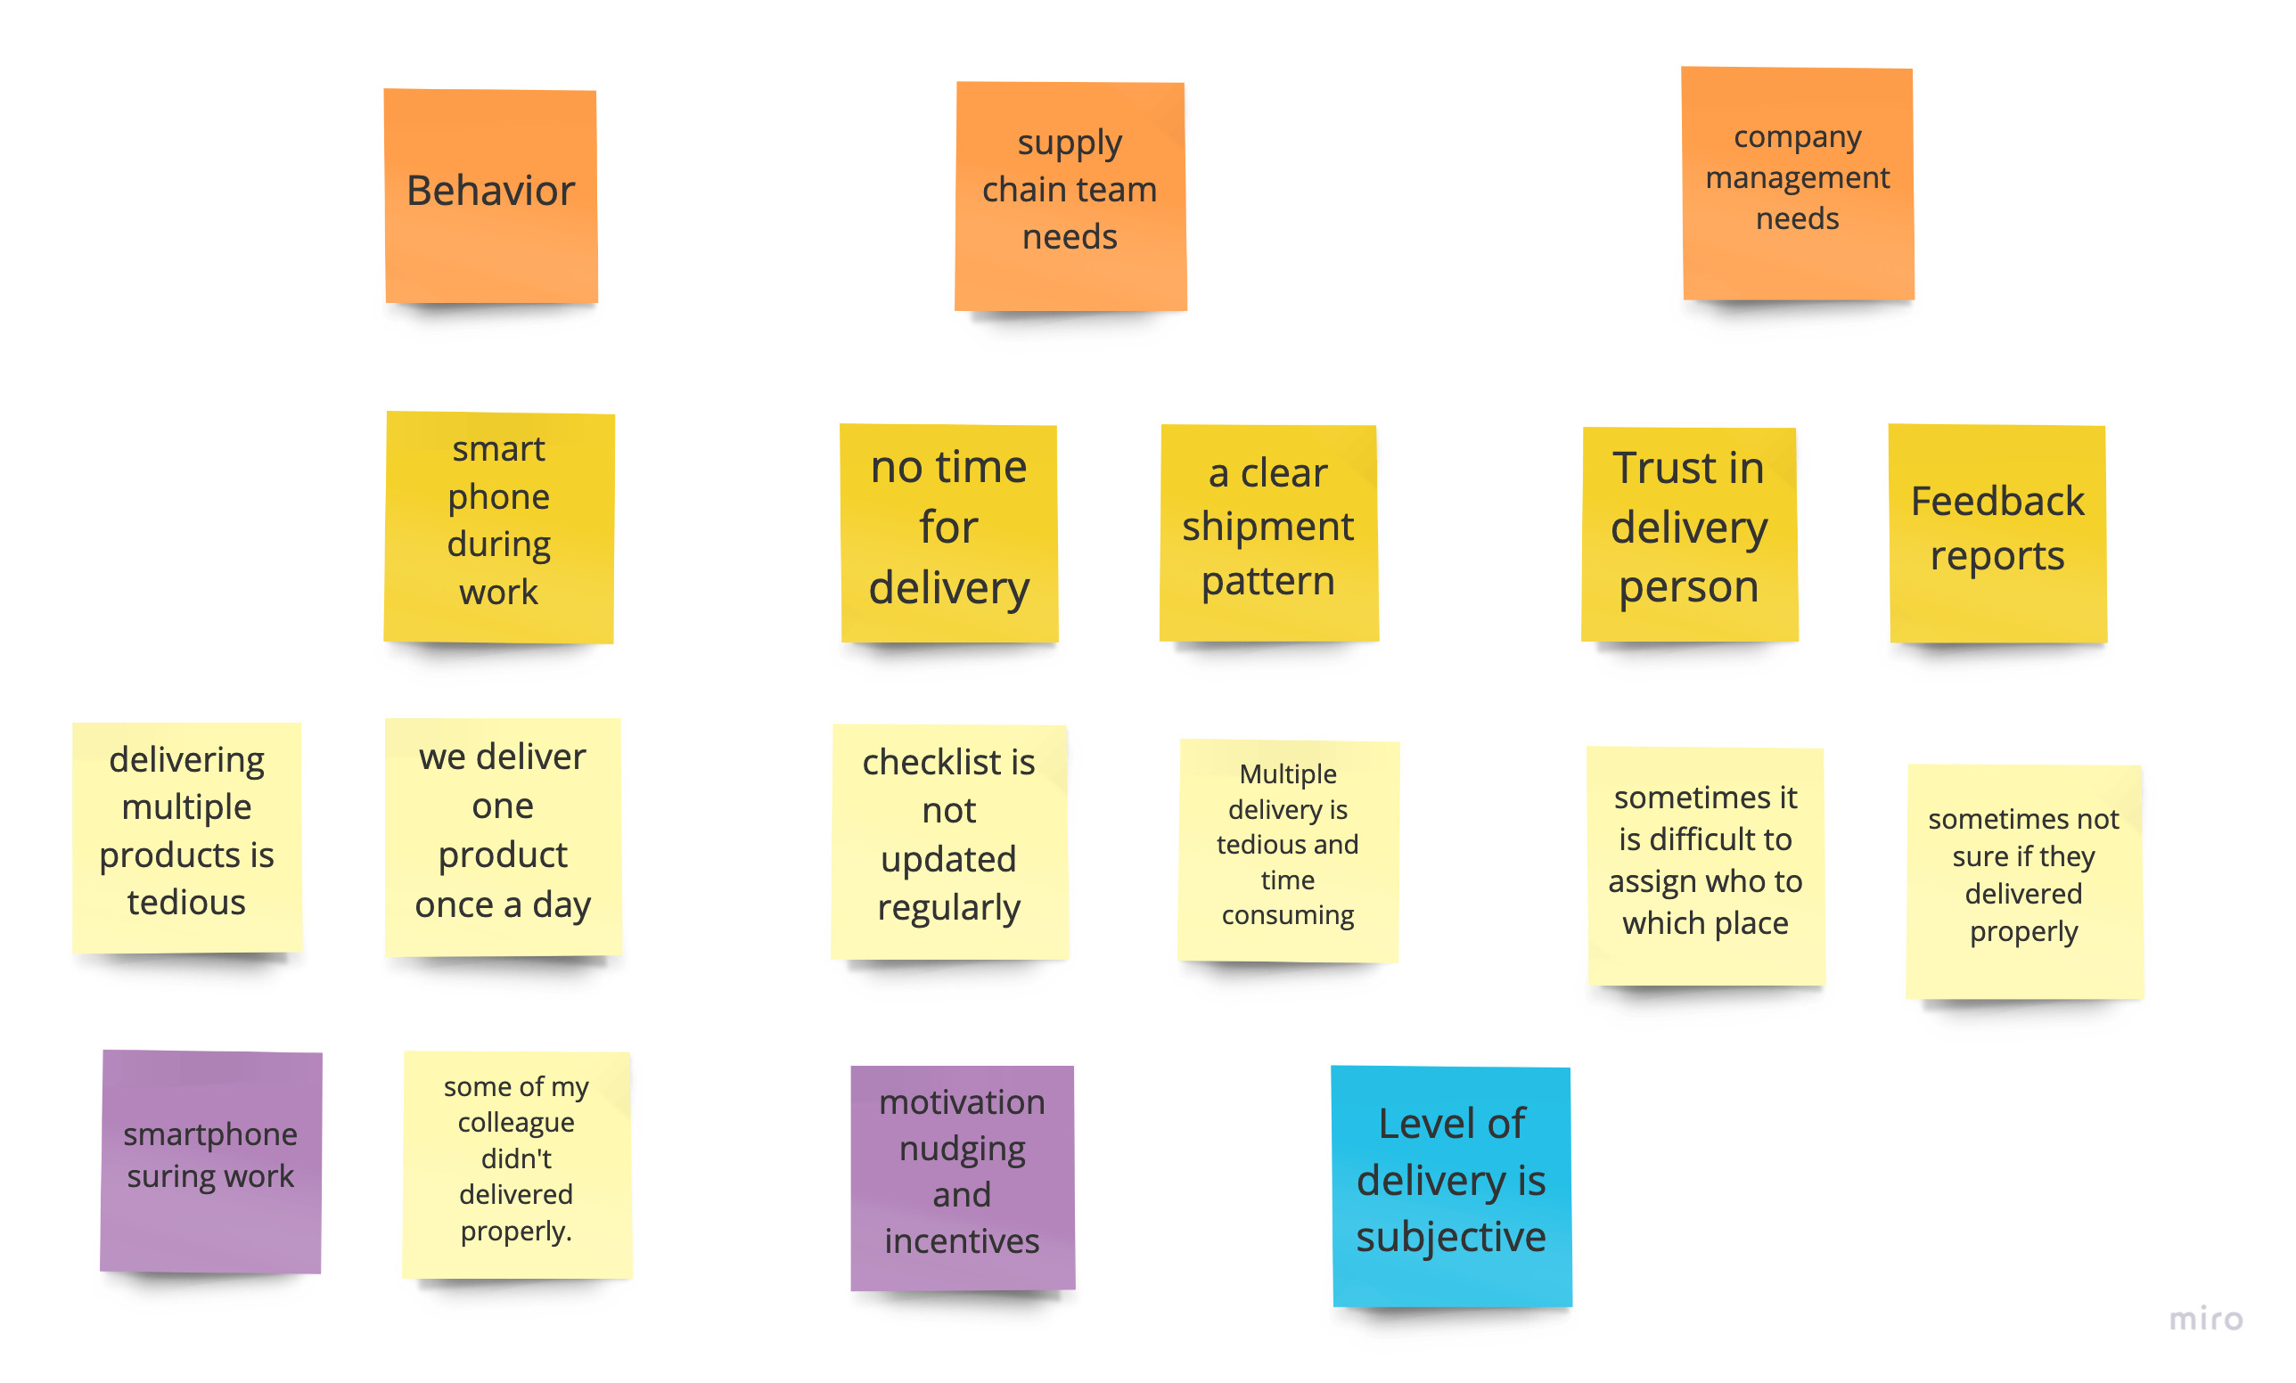
Data Collection and Analysis

